Slide 1
GRAMMAR REVIEW GAME
FRAGMENTS
RUN ONS / COMMA SPLICES
COMPLEX SENTENCES
QUOTING AND CITING
PUNCTUATING TITLES

Slide 2
TO DETERMINE HOW TO PUNCTUATE A TITLE, YOU FIRST NEED TO DETERMINE IF IT IS CONSIDERED A BIG PIECE OF WORK OR A SMALL PIECE OF WORK
BIG THINGS
“SMALL” TH
BOOK
MAGAZINE
CD TITLE
MOVIE
PLAY
BOOK CHAPTER
MAGAZINE ARTICLE
SONG
SHORT STORY
POEM
Small things are normally read or viewed in ONE sitting -- less than an hour.

Slide 3
LITTLE TITLES (Things read / viewed in ONE sitting)
SHORT STORIES, CHAPTER TITLES, NEWSPAPER ARTICLES, POEMS, SONGS
THINGS THAT NORMALLY CAN BE READ IN ONE SITTING
GO IN “ ”

Slide 4
BIG THINGS (Things that take over 45 min to view or read)
NEWSPAPERS, BOOKS, MOVIES, CD TITLE, MAGAZINES
ARE UNDERLINED OR IN ITALICS

Slide 5
Underlining and Italics are interchangeable when punctuating TITLES
1) True
2) False
Notes:
🍐 This is a Pear Deck Multiple Choice Slide. Your current options are: A: True / yes they are, B: False/ no they are not,
🍐 To edit the type of question or choices, go back to the "Ask Students a Question" in the Pear Deck sidebar.

Slide 6
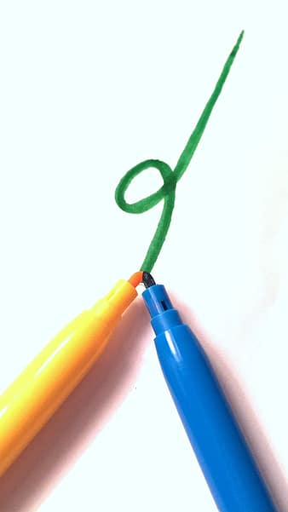
TRUE!
Books, Plays, Movies can be EITHER underlined OR in italics.
Things that take LONGER than 45 min to read, view, or listen to should be put in italics or underlined.

Slide 7
You can start a sentence with because
Yes
No
Notes:
🍐 This is a Pear Deck Multiple Choice Slide. Your current options are: A: yes, B: no,
🍐 To edit the type of question or choices, go back to the "Ask Students a Question" in the Pear Deck sidebar.

Slide 8
YES you can.
You just need to join it w/ an independent clause.
Because I love cars, I’m going to be a mechanic.

Slide 9
Book Titles Need to be
Underlined or in Italics
In quotes
Notes:
🍐 This is a Pear Deck Multiple Choice Slide. Your current options are: A: underlined or in italics, B: in quotation marks,
🍐 To edit the type of question or choices, go back to the "Ask Students a Question" in the Pear Deck sidebar.

Slide 10
Books are underlined or in italics
ALL large works are underlined or in italics

Slide 11
Short Story Titles should be
1) Underlined or in Italics
2) In Quotes
Notes:
🍐 This is a Pear Deck Multiple Choice Slide. Your current options are: A: underlined or in italics, B: quotation marks,
🍐 To edit the type of question or choices, go back to the "Ask Students a Question" in the Pear Deck sidebar.

Slide 12
2) Short Stories and other shorter works are in quotation marks
QUOTES are LITTLE and they are used with SHORTER texts

Slide 13
TRUE/FALSE: Both are correct
Since I have a big family, we have large holiday parties.
We have large holiday parties since we have a big family.
True
False
Notes:
True or False
Use this template to do a quick check of students’ perceptions during your lesson.
🍐 This is a Pear Deck Multiple Choice Slide. Your current options are: A: True, B: False,
🍐 To edit the type of question or choices, go back to the "Ask Students a Question" in the Pear Deck sidebar.

Slide 14
TRUE / YES BOTH ARE CORRECT
Even though they are the same words, one needs a comma and one does not need a comma.
When the DEPENDENT clause comes FIRST you DO need a comma
When the DEPENDENT clause comes LAST you do NOT need a comma
Since I have a big family, we have large holiday parties.|
We have large holiday parties since we have a big family.

Slide 15
WHICH ONE IS CORRECT?
“If people were rain, I was drizzle, and she was a hurricane” (John Green 202).
“If people were rain, I was drizzle, and she was a hurricane” (Green 202).
“If people were rain, I was drizzle, and she was a hurricane” (Green, 202).
Notes:
🍐 This is a Pear Deck Multiple Choice Slide. Your current options are: A: underlined or in italics, B: Quotation Marks,
🍐 To edit the type of question or choices, go back to the "Ask Students a Question" in the Pear Deck sidebar.

Slide 16
#2 is CORRECT
“If people were rain, I was drizzle, and she was a hurricane” (John Green 202). NO FIRST name needed
“If people were rain, I was drizzle, and she was a hurricane” (Green 202). CORRECT
“If people were rain, I was drizzle, and she was a hurricane” (Green, 202). NO comma needed
Notes:
🍐 This is a Pear Deck Multiple Choice Slide. Your current options are: A: underlined or in italics, B: Quotation Marks,
🍐 To edit the type of question or choices, go back to the "Ask Students a Question" in the Pear Deck sidebar.

Slide 17
Newspapers along with other longer works are
Underlined or in italics

Slide 18
Because I love math, I am going to become an engineer.
Correct
Incorrect
Notes:
🍐 This is a Pear Deck Multiple Choice Slide. Your current options are: A: correct, B: incorrect,
🍐 To edit the type of question or choices, go back to the "Ask Students a Question" in the Pear Deck sidebar.

Slide 19
Correct
Because I love math, I am going to become and engineer. It is a complex sentence.
Comma needed because it started w/ a dependent clause.

Slide 20
SELECT THE CORRECT ONE:
A) “Comrades, surely you don’t want Jones to come back” (Orwell 52). B) “Comrades, surely you don’t want Jones to come back.” (Orwell 52). C) “Comrades, surely you don’t want Jones to come back” (Orwell page 52).
Notes:
🍐 This is a Pear Deck Multiple Choice Slide. Your current options are: A: A, B: B, C: C,
🍐 To edit the type of question or choices, go back to the "Ask Students a Question" in the Pear Deck sidebar.

Slide 21
A)“Comrades, surely you don’t want Jones to come back” (Orwell 52).
NO period before the ( )
NO word page in the ( )

Slide 22
SELECT the CORRECT ONE:
A) “Tactics comrades, tactics” (Orwell 93)!
B) “Tactics comrades, tactics!” (Orwell 93).
Notes:
🍐 This is a Pear Deck Multiple Choice Slide. Your current options are: A: A, B: B,
🍐 To edit the type of question or choices, go back to the "Ask Students a Question" in the Pear Deck sidebar.

Slide 23
B) “Tactics comrades, tactics!” (Orwell 93).
IF the quote ends w/ a ! or ? you keep it and then add a . at the end.

Slide 24
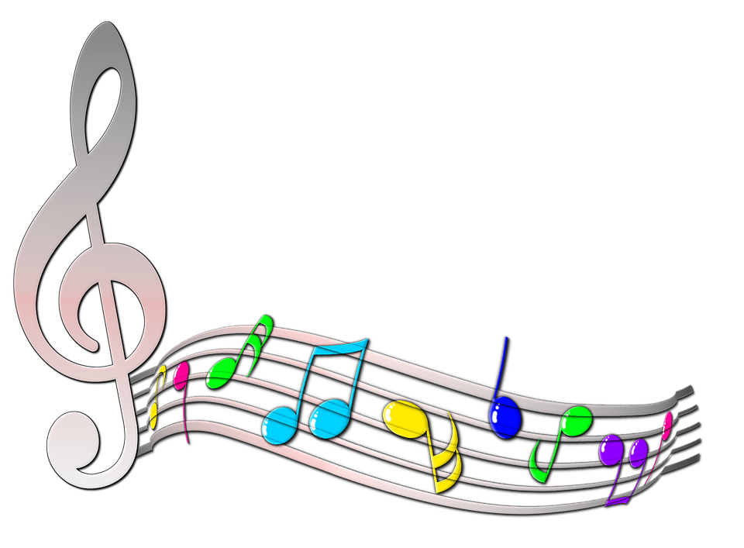
Song Titles
Underline or Italics
OR
Quotation Marks
Notes:
🍐 This is a Pear Deck Multiple Choice Slide. Your current options are: A: underlined or in italics, B: quotation marks,
🍐 To edit the type of question or choices, go back to the "Ask Students a Question" in the Pear Deck sidebar.

Slide 25
Song Titles and other short works are in
2) quotation marks

Slide 26
Movie Titles should be in:
Italics or Underlined
Quotation marks
Notes:
🍐 This is a Pear Deck Multiple Choice Slide. Your current options are: A: underlined or in italics, B: quotation marks,
🍐 To edit the type of question or choices, go back to the "Ask Students a Question" in the Pear Deck sidebar.

Slide 27
Movies and other large works should be in ITALICS or UNDERLINED

Slide 28
TRUE/ FALSE this is a run on:
I love sports, my soccer team just won the conference.
True
False
Notes:
True or False
Use this template to do a quick check of students’ perceptions during your lesson.
🍐 This is a Pear Deck Multiple Choice Slide. Your current options are: A: True, B: False,
🍐 To edit the type of question or choices, go back to the "Ask Students a Question" in the Pear Deck sidebar.

Slide 29
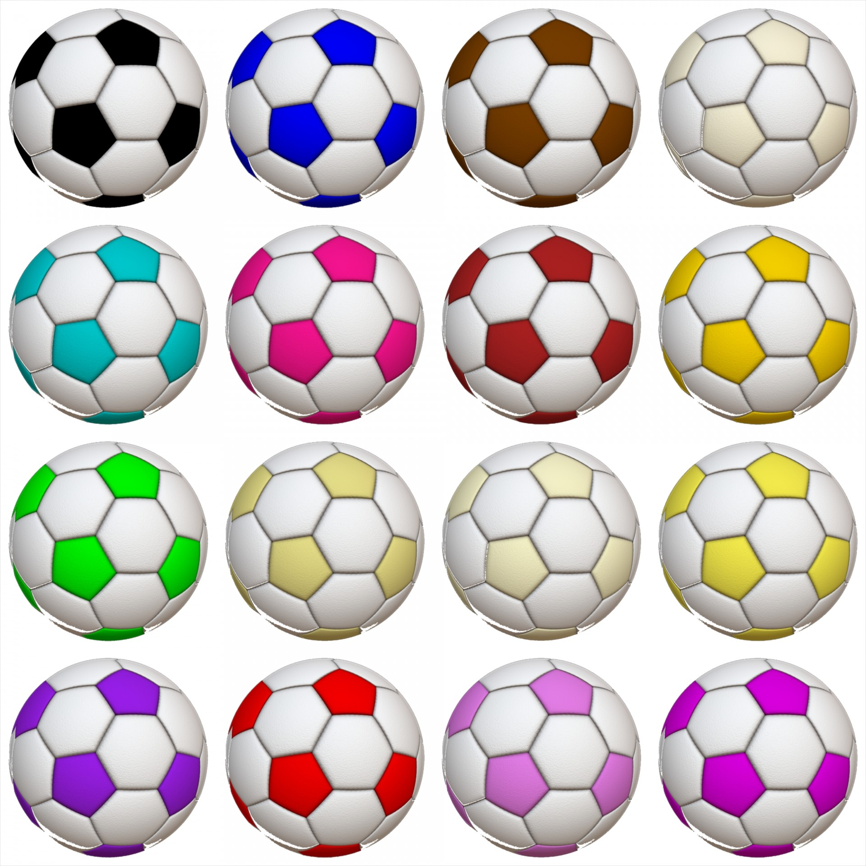
TRUE IT IS A RUN ON
A comma is not strong enough to join two complete sentences.
I love sports, my soccer team just won the conference. (INCORRECT)
I love sports; in fact, my soccer team just won the conference. (CORRECT)
I love sports, and my soccer team just won the
conference. (CORRECT)

Slide 30
A) I love English class; because Ms. Kaminski rocks. B) I love English class because Ms. Kaminski rocks.
Notes:
🍐 This is a Pear Deck Multiple Choice Slide. Your current options are: A: a, B: b,
🍐 To edit the type of question or choices, go back to the "Ask Students a Question" in the Pear Deck sidebar.

Slide 31
B) I love English class because Ms. Kaminski rocks.
You can only put a semicolon where you can put a period and BECAUSE Ms. KAMINSKI rocks is a dependent clause that can NOT stand alone.

Slide 32
I love kitties, I don’t have one because I am allergic.
Delete Comma
Run on, Comma Splice
Correct As Is
Notes:
🍐 This is a Pear Deck Multiple Choice Slide. Your current options are: A: Delete comma, B: run on / comma splice, C: Correct as is,
🍐 To edit the type of question or choices, go back to the "Ask Students a Question" in the Pear Deck sidebar.

Slide 33
2) Run on, Comma Splice
I love kitties, I don’t have one because I am allergic.
A comma is NOT strong enough to join two sentences.
Comma and FANBOY (for, and, nor, but, or, yet, so)
Period
semicolon
Run ons CAN be short

Slide 34
I am showing cattle at the fair, I am hoping to take first place.
Correct
Run On / Comma Splice
Notes:
🍐 This is a Pear Deck Multiple Choice Slide. Your current options are: A: correct as is, B: run on / comma splice,
🍐 To edit the type of question or choices, go back to the "Ask Students a Question" in the Pear Deck sidebar.

Slide 35
I am showing cattle at the fair, I am hoping to take first place.
2) Run On / Comma Splice
Two complete sentences can NOT be joined w/ a comma alone.

Slide 36
TRUE OR FALSE: both are correct Since I love guacamole, I am bringing it to the party.
I am bringing guacamole to the party, since I like it.
True
False
Notes:
True or False
Use this template to do a quick check of students’ perceptions during your lesson.
🍐 This is a Pear Deck Multiple Choice Slide. Your current options are: A: True, B: False,
🍐 To edit the type of question or choices, go back to the "Ask Students a Question" in the Pear Deck sidebar.

Slide 37
NO/FALSE
NO comma is needed when the dependent clause comes second.
Since I love guacamole, I am bringing it to the party.
I am bringing guacamole to the party, since I like it. (This is WRONG)

Slide 38
Circle how you are feeling:
Notes:
🍐 This is a Pear Deck Draggable™ Slide.
🍐 To edit the type of question, go back to the "Ask Students a Question" in the Pear Deck sidebar.
Emotion Check
Use this template to prompt students to check in with themselves. This will also help you gauge the mood in your classroom and notice any students who might attention.

Slide 39
Select the one that is NOT correct:
I am going to go shopping because I need new shoes.
Because I need new shoes, I am going shopping
Because I need shoes I am going shopping.
Notes:
🍐 This is a Pear Deck Multiple Choice Slide. Your current options are: A: 1, B: 2, C: 3,
🍐 To edit the type of question or choices, go back to the "Ask Students a Question" in the Pear Deck sidebar.

Slide 40
ERROR:
3) Because I need shoes I am going shopping.
COMMA needed after the dependent clause that starts the sentence:
Because I need shoes, I am going shopping.

Slide 41
Because I have lots of cousins.
Independent clause
Dependent clause
Notes:
🍐 This is a Pear Deck Multiple Choice Slide. Your current options are: A: independent clause, B: dependent clause,
🍐 To edit the type of question or choices, go back to the "Ask Students a Question" in the Pear Deck sidebar.

Slide 42
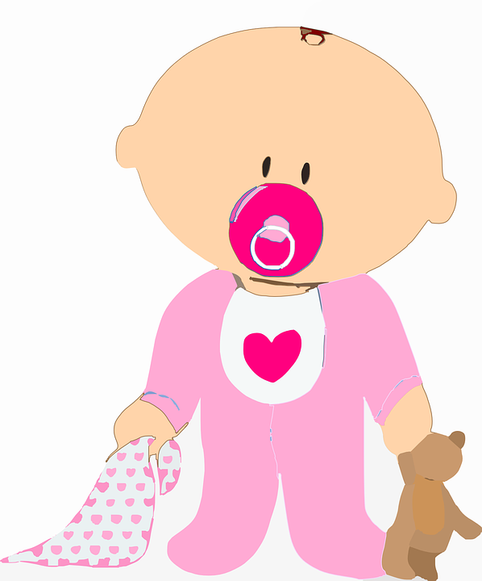
2) Dependent Clause
Because I have lots of cousins.
Fragment
Can’t stand on its own just like babies are dependent on others

Slide 43
Where ever you can put a period, you can put a semicolon.
True
False
Notes:
True or False
Use this template to do a quick check of students’ perceptions during your lesson.
🍐 This is a Pear Deck Multiple Choice Slide. Your current options are: A: True, B: False,
🍐 To edit the type of question or choices, go back to the "Ask Students a Question" in the Pear Deck sidebar.

Slide 44
Where ever you can put a period, you can put a semicolon.
TRUE
Everything BEFORE and everything AFTER a semicolon must be a complete sentence.

Slide 45
Anything you take word for word from a book is a quote. It does NOT need to be in “ “ in the book to be a quote.
True
False
Notes:
True or False
Use this template to do a quick check of students’ perceptions during your lesson.
🍐 This is a Pear Deck Multiple Choice Slide. Your current options are: A: True, B: False,
🍐 To edit the type of question or choices, go back to the "Ask Students a Question" in the Pear Deck sidebar.

Slide 46
TRUE
YES anything you take word from word in a book it a quote including narration. It does NOT have to be dialogue to be a quote

Slide 47
A comma splice is a type of an error where there are two complete sentences joined w/ a comma.
True
False
Notes:
True or False
Use this template to do a quick check of students’ perceptions during your lesson.
🍐 This is a Pear Deck Multiple Choice Slide. Your current options are: A: True, B: False,
🍐 To edit the type of question or choices, go back to the "Ask Students a Question" in the Pear Deck sidebar.

Slide 48
TRUE
A comma is NOT strong enough to join two complete sentences.
Comma and FANBOYS (for, and, nor, but, or yet, so)
Period
Semicolon
A comma splice is a form of a run on which is an error.

Slide 49
Drag your dot to how you are feeling:
Keep going, I understand
I’m a little confused
Stop, I need help!
Notes:
Temperature Check
WIth this slide, you can get a quick idea of how your students are feeling about the pace of the lesson. Getting consensus before moving on helps ensure everyone is still with you, and identify the students who might need extra attention.
🍐 This is a Pear Deck Draggable™ Slide.
🍐 To edit the type of question, go back to the "Ask Students a Question" in the Pear Deck sidebar.

Slide 50
Need more review?
CLICK HERE FOR MORE ONLINE REVIEW!!

